Slide 1
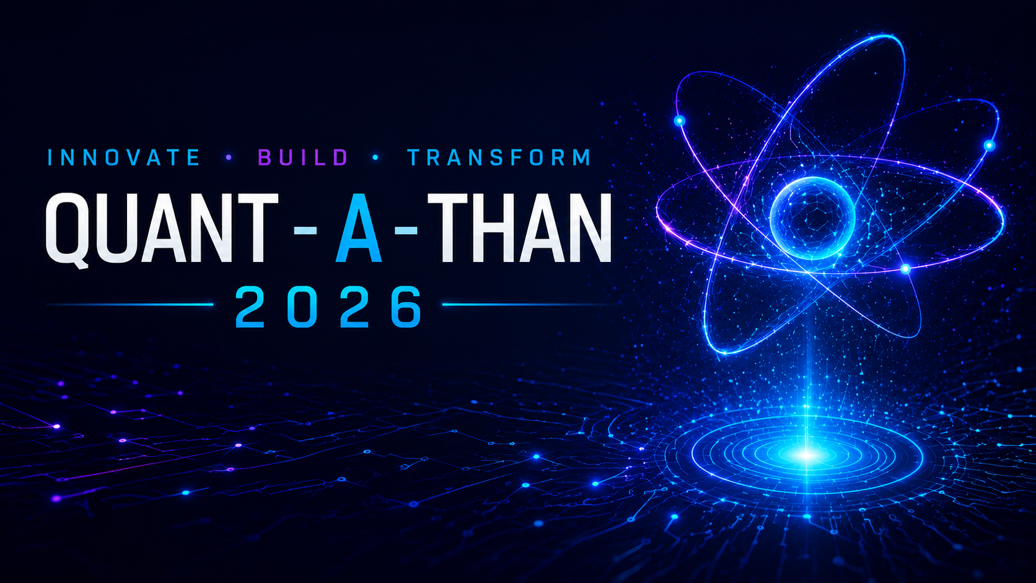





Q-GUARD AI
Multi-Agent Quantum Fraud Intelligence
Team Name : Schrödinger’s Coders
Members: Dhinith Pragalyan M, Dhanveer M, Venkatesan S, Elamaran B Panimalar engineering college , Chennai.

Slide 2
1. PROBLEM STATEMENT (QT-2.8)
Mule Fund Relays: Syndicates route stolen funds through intermediate accounts in minutes.
Device Farms: Fraudsters use virtual emulators to spoof 'trusted devices' at scale.
Velocity Structuring: Bots slice transactions into micro-amounts below default detection limits.
Linear Blindspot: Traditional rules evaluate details in isolation, missing non-linear loops.
Solution: Q-Guard AI blends Multi-Agent ingestion with a Parameterized Quantum Circuit.

Slide 3
2. WHY CLASSICAL MACHINE LEARNING FAILS
High False Positives: Static rules trigger blocks on regular traveler activity, creating churn.
Dimensionality Curse: Linking deep behavior details requires heavy classical networks.
Black-Box Decisioning: Deep learning models cannot explain logs for audit compliance.
Rigid Threshold Limits: Static fraud limits leave banks open to off-peak night exploits.

Slide 4
3. THE QUANTUM ADVANTAGE (QML LAYER)
Non-Linear Correlation: Quantum state entanglements capture inter-agent correlations naturally.
Parameter Efficiency: A 4-qubit classifier uses 90% fewer weights than classical models.
Hilbert Mapping: Translates complex user behavior metrics to subatomic quantum states.
Hardware Readiness: Designed to plug natively into physical NISQ QPUs (like IBM Quantum).

Slide 5
4. MULTI-AGENT INGESTION ARCHITECTURE
User Agent: Analyzes spending limit fraction deviations and transaction timestamps.
Device Agent: Assesses browser attributes, OS versions, emulator footprints, and device age.
Merchant Agent: Monitors seller category hazard levels and historic chargeback metrics.
Network Agent: Assesses VPN/proxy usage, geodistance anomalies, and impossible travel velocity.
Decentralized Design: Ensures multiple threat dimensions are ingested simultaneously.

Slide 6
5. BLOCH SPHERE & STATE VECTOR MAPPING
Angle Encoding: Local agent threat outputs (0 to 1) map to rotation angles (0 to Pi).
Qubit Allocation: Initializes a 4-qubit state, applying Ry rotation gates to each qubit.
Bloch Projections: Risk levels are mapped as coordinates on a 3D Bloch Sphere vector.
Excitation Tracking: Elevated telemetry flags push the state vectors closer to the |1> pole.

Slide 7
6. VARIATIONAL QUANTUM CIRCUIT (VQC) DETAILS
Ansatz Entanglement: Connects qubits in a ring topology (Q0->Q1->Q2->Q3->Q0) using CNOT gates.
Coordinated Learning: Entanglement allows Q-Guard to associate user details with device risk.
Variational Tuning: Fine-tunes model weights dynamically using rotation parameter loops.
Output Expectation: Calculates the Z-axis expectation value of each qubit upon measurement.

Slide 8
7. DYNAMIC BLOCH VECTOR WEIGHTING
Dynamic Weights: Calculates weights directly from Bloch Z-projection: W = (1 - Z)/2.
Adaptive Focus: System dynamically shifts priority to the agent showing the highest anomaly.
Combined Risk Scoring: Calculates final score as a weighted sum of qubit measurements.
Noise Suppression: Low-risk background telemetry is dynamically ignored to save database bandwidth.

Slide 9
8. ADAPTIVE CONTEXT THRESHOLD ENGINE
Dynamic Guardrails: Replaces flat, static 80% limits with context-aware boundaries.
Time Window (12 AM - 5 AM): Threshold drops to 65% to defend against off-hour scams.
Merchant Context: Limit drops to 58% for high-hazard category terminal devices.
Customer Context: Threshold relaxes to 95% for trusted, long-standing user profiles.

Slide 10
9. SELF-EXPLAINABLE AI (XAI) & AUDITING
Translation Pipeline: Converts VQC coordinates into natural language audit logs.
Regulatory Compliance: Outlines exactly why a transaction was flagged or blocked.
Anti-Black Box: Ensures fraud analysts can explain any system decision to RBI auditors.
Visual Threat Mapping: Provides a dynamic 3D visual of the Bloch sphere state space.

Slide 11
10. STRATEGIC MITIGATION CHECKLISTS
Multi-Stage Security: Replaces crude binary block decisions with progressive checklists.
Low Risk: Process transaction instantly (frictionless flow).
Medium Risk: Prompt for SMS OTP and email code verification.
High Risk: Require biometric Face Authentication check.
Critical Risk: Freeze transaction and alert the bank's fraud mitigation desk.

Slide 12
11. SCALABILITY & DATABASE INTEGRATION
Dataset Loading: Mapped to 3,000 real-world transaction logs from the Kaggle dataset.
MongoDB Pipeline: Stores telemetry, dynamic weights, and strategies in indexed collections.
FastAPI REST Endpoints: Exposes Bloch coordinates, agent weights, and explanation logs.
Vercel Deployment: Live static visualizer deployed on secure cloud servers.

Slide 13
12. FUTURE SCOPE & CONCLUSION
QPU Deployment: Porting the simulated quantum layers directly to physical IBM QPUs.
Graph Neural Network (GNN): Merging VQC with GNNs to trace large money laundering rings.
Open Banking API: Packaging Q-Guard as a plug-and-play middleware module.
Schrödinger's Coders: Securing the future of payments using quantum computing principles.

